Slide 1


CUSTOMER OPERATIONS INTELLIGENCE
Call Center Performance Analysis
A dynamic Power BI solution to visualize Sales Rep productivity, response efficiency, and operational patterns.

Slide 2
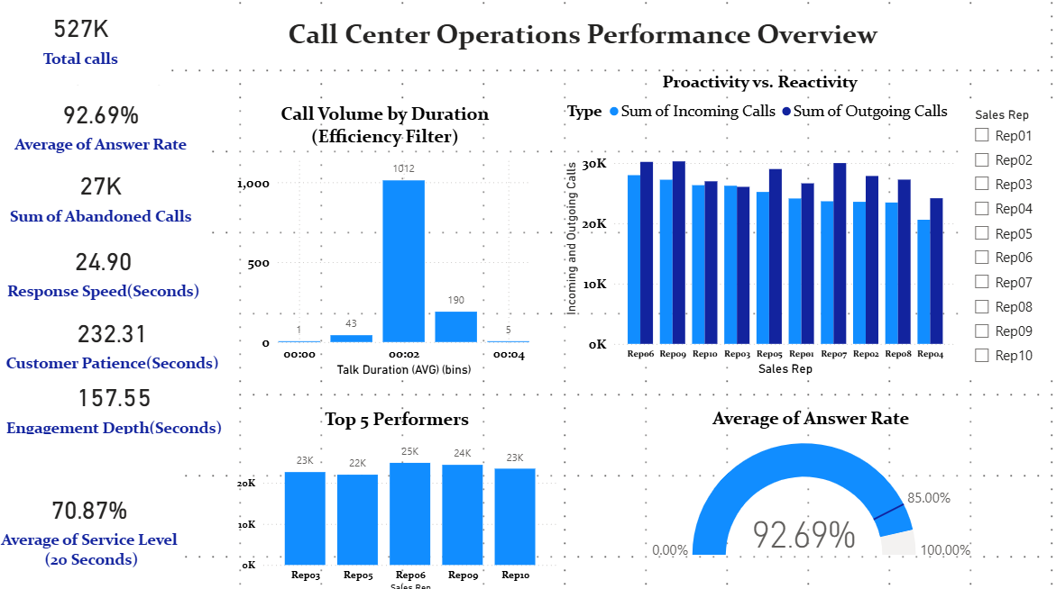
BUSINESS OBJECTIVE & DATA SCOPE
The Goal
Identify patterns in communication efficiency to drive decision-making. The project focuses on Sales Rep performance, call volumes (Incoming/Outgoing), and time-based metrics like Talk Duration vs. Waiting Time.
Dataset: Sales Rep Activity Logs (Calls, Speed, Duration, Service Level)

Slide 3


SOLUTION ARCHITECTURE: CORE KPIS
Rep Performance
Operational Metrics
▪
Call Balance: Visualization of Outgoing vs. Incoming distribution.
▪
Answer Rate: Efficiency of handling incoming traffic.
▪
Service Level (20s): The percentage of calls answered within the critical 20-second threshold.
▪
Top 3 Outbound Leaders: Identifying the most proactive representatives.
▪
Abandoned Calls: Lost opportunities identified by Rep ID.
▪
Top 5 Volume Handlers: Total load capacity per Sales Rep.

Slide 4
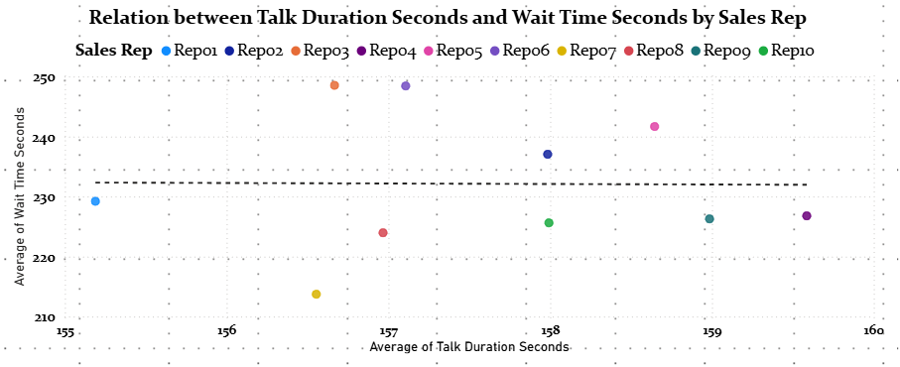
PATTERN DISCOVERY: EFFICIENCY INSIGHTS
Meaningful Patterns
Observation: Analysis revealed a negative correlation between Average Waiting Time and Service Level. Talk Duration: Longer talk durations do not always correlate with higher sales, but do correlate with lower overall call volume per Rep, suggesting a need for "Average Handle Time" (AHT) optimization.

Slide 5



CONCLUSION & BUSINESS IMPACT
Resource Optimization
UX-Driven CX
Next Steps
Identify underperforming reps by comparing their volume vs. speed of answer, enabling targeted coaching.
By maintaining high User Experience in the dashboard, stakeholders can pivot from data viewing to decision-making in seconds.
Integrate sentiment analysis from call transcripts to correlate 'Talk Duration' with actual customer satisfaction scores.

